Slide 1

Notes:
@design: design-title @slide: slide-title-norwegian-red-cross

Slide 2
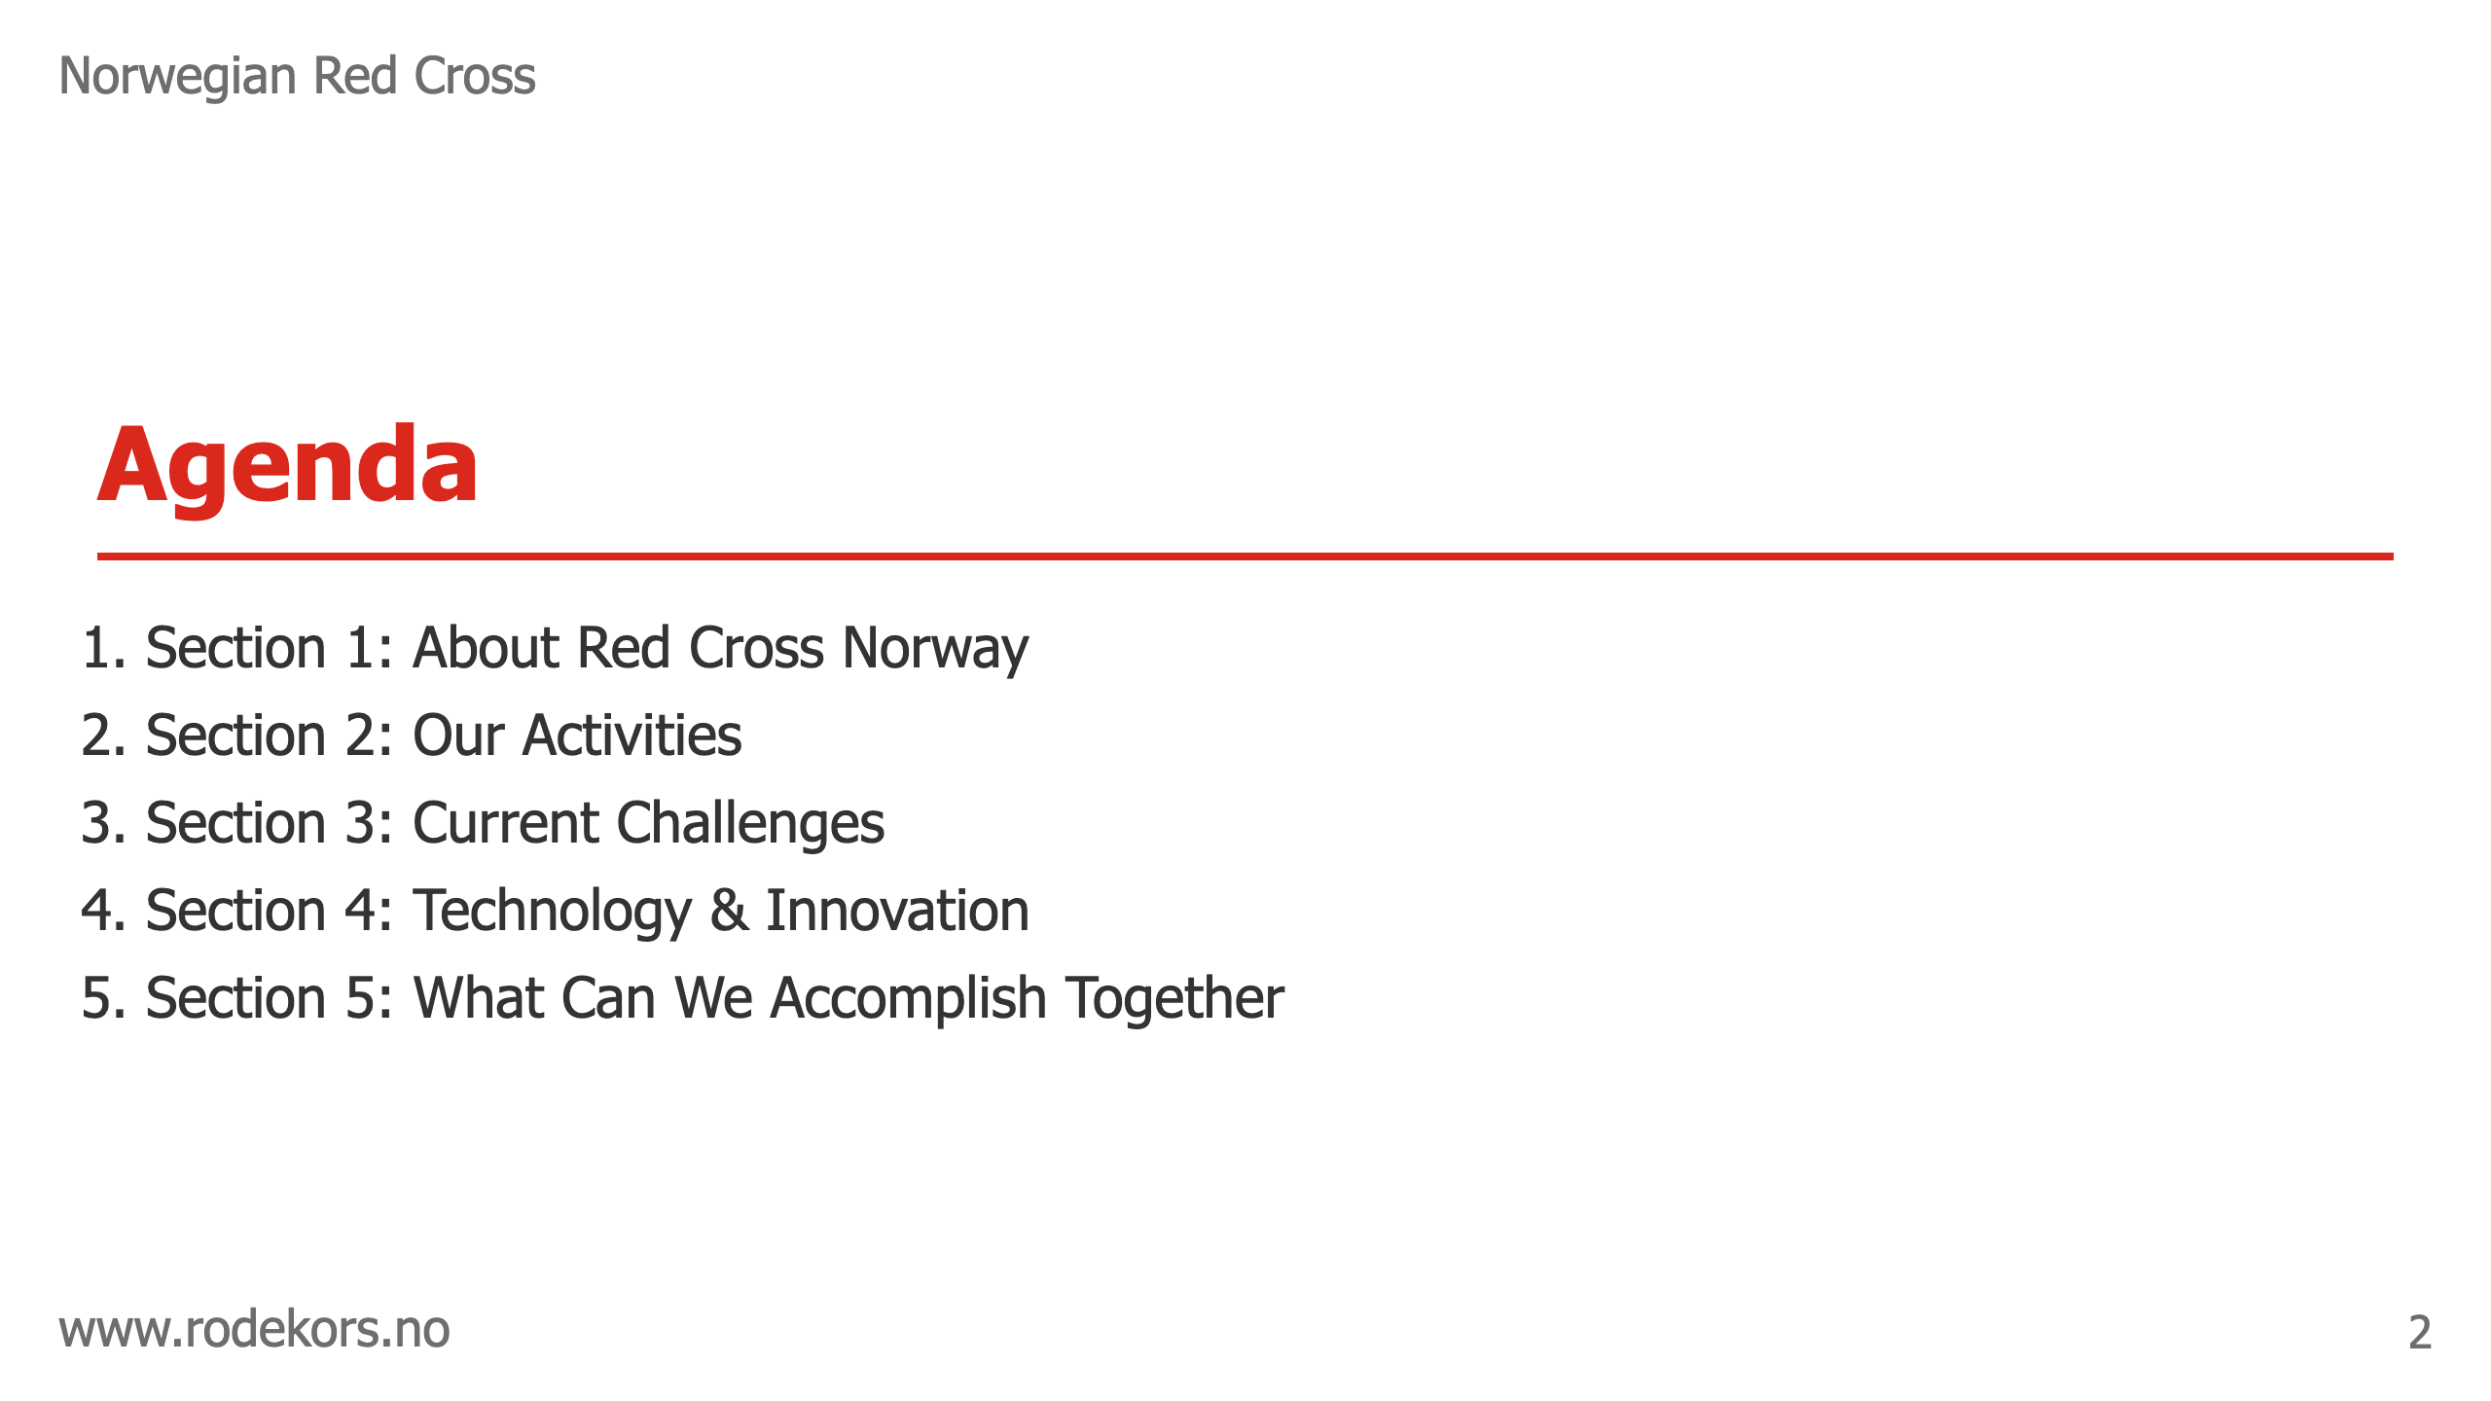
Notes:
@design: design-agenda @slide: slide-agenda

Slide 3

Notes:
@design: design-section-divider @slide: slide-section-1-intro Introduce who we are, our mission, scale, and foundation of our work.

Slide 4
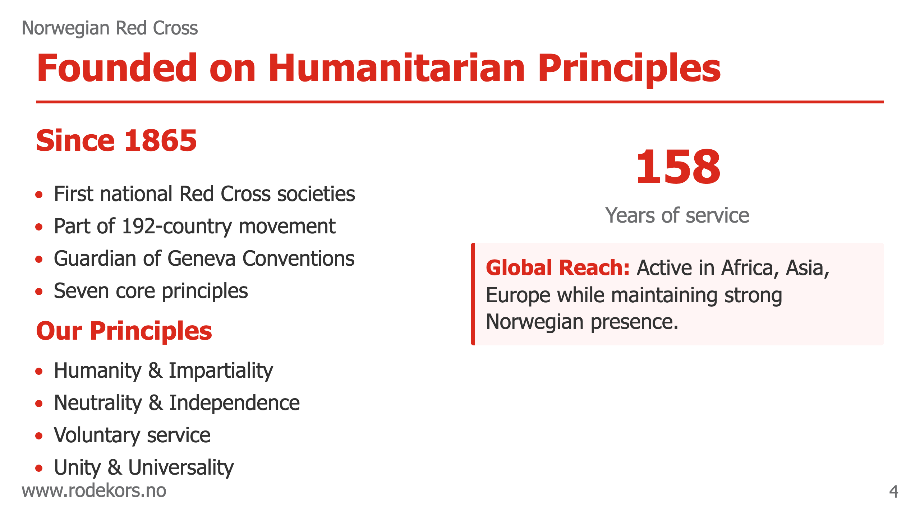
Notes:
@design: design-2-columns-stats @slide: slide-founded-on-principles Emphasize history and principles that guide our work.

Slide 5
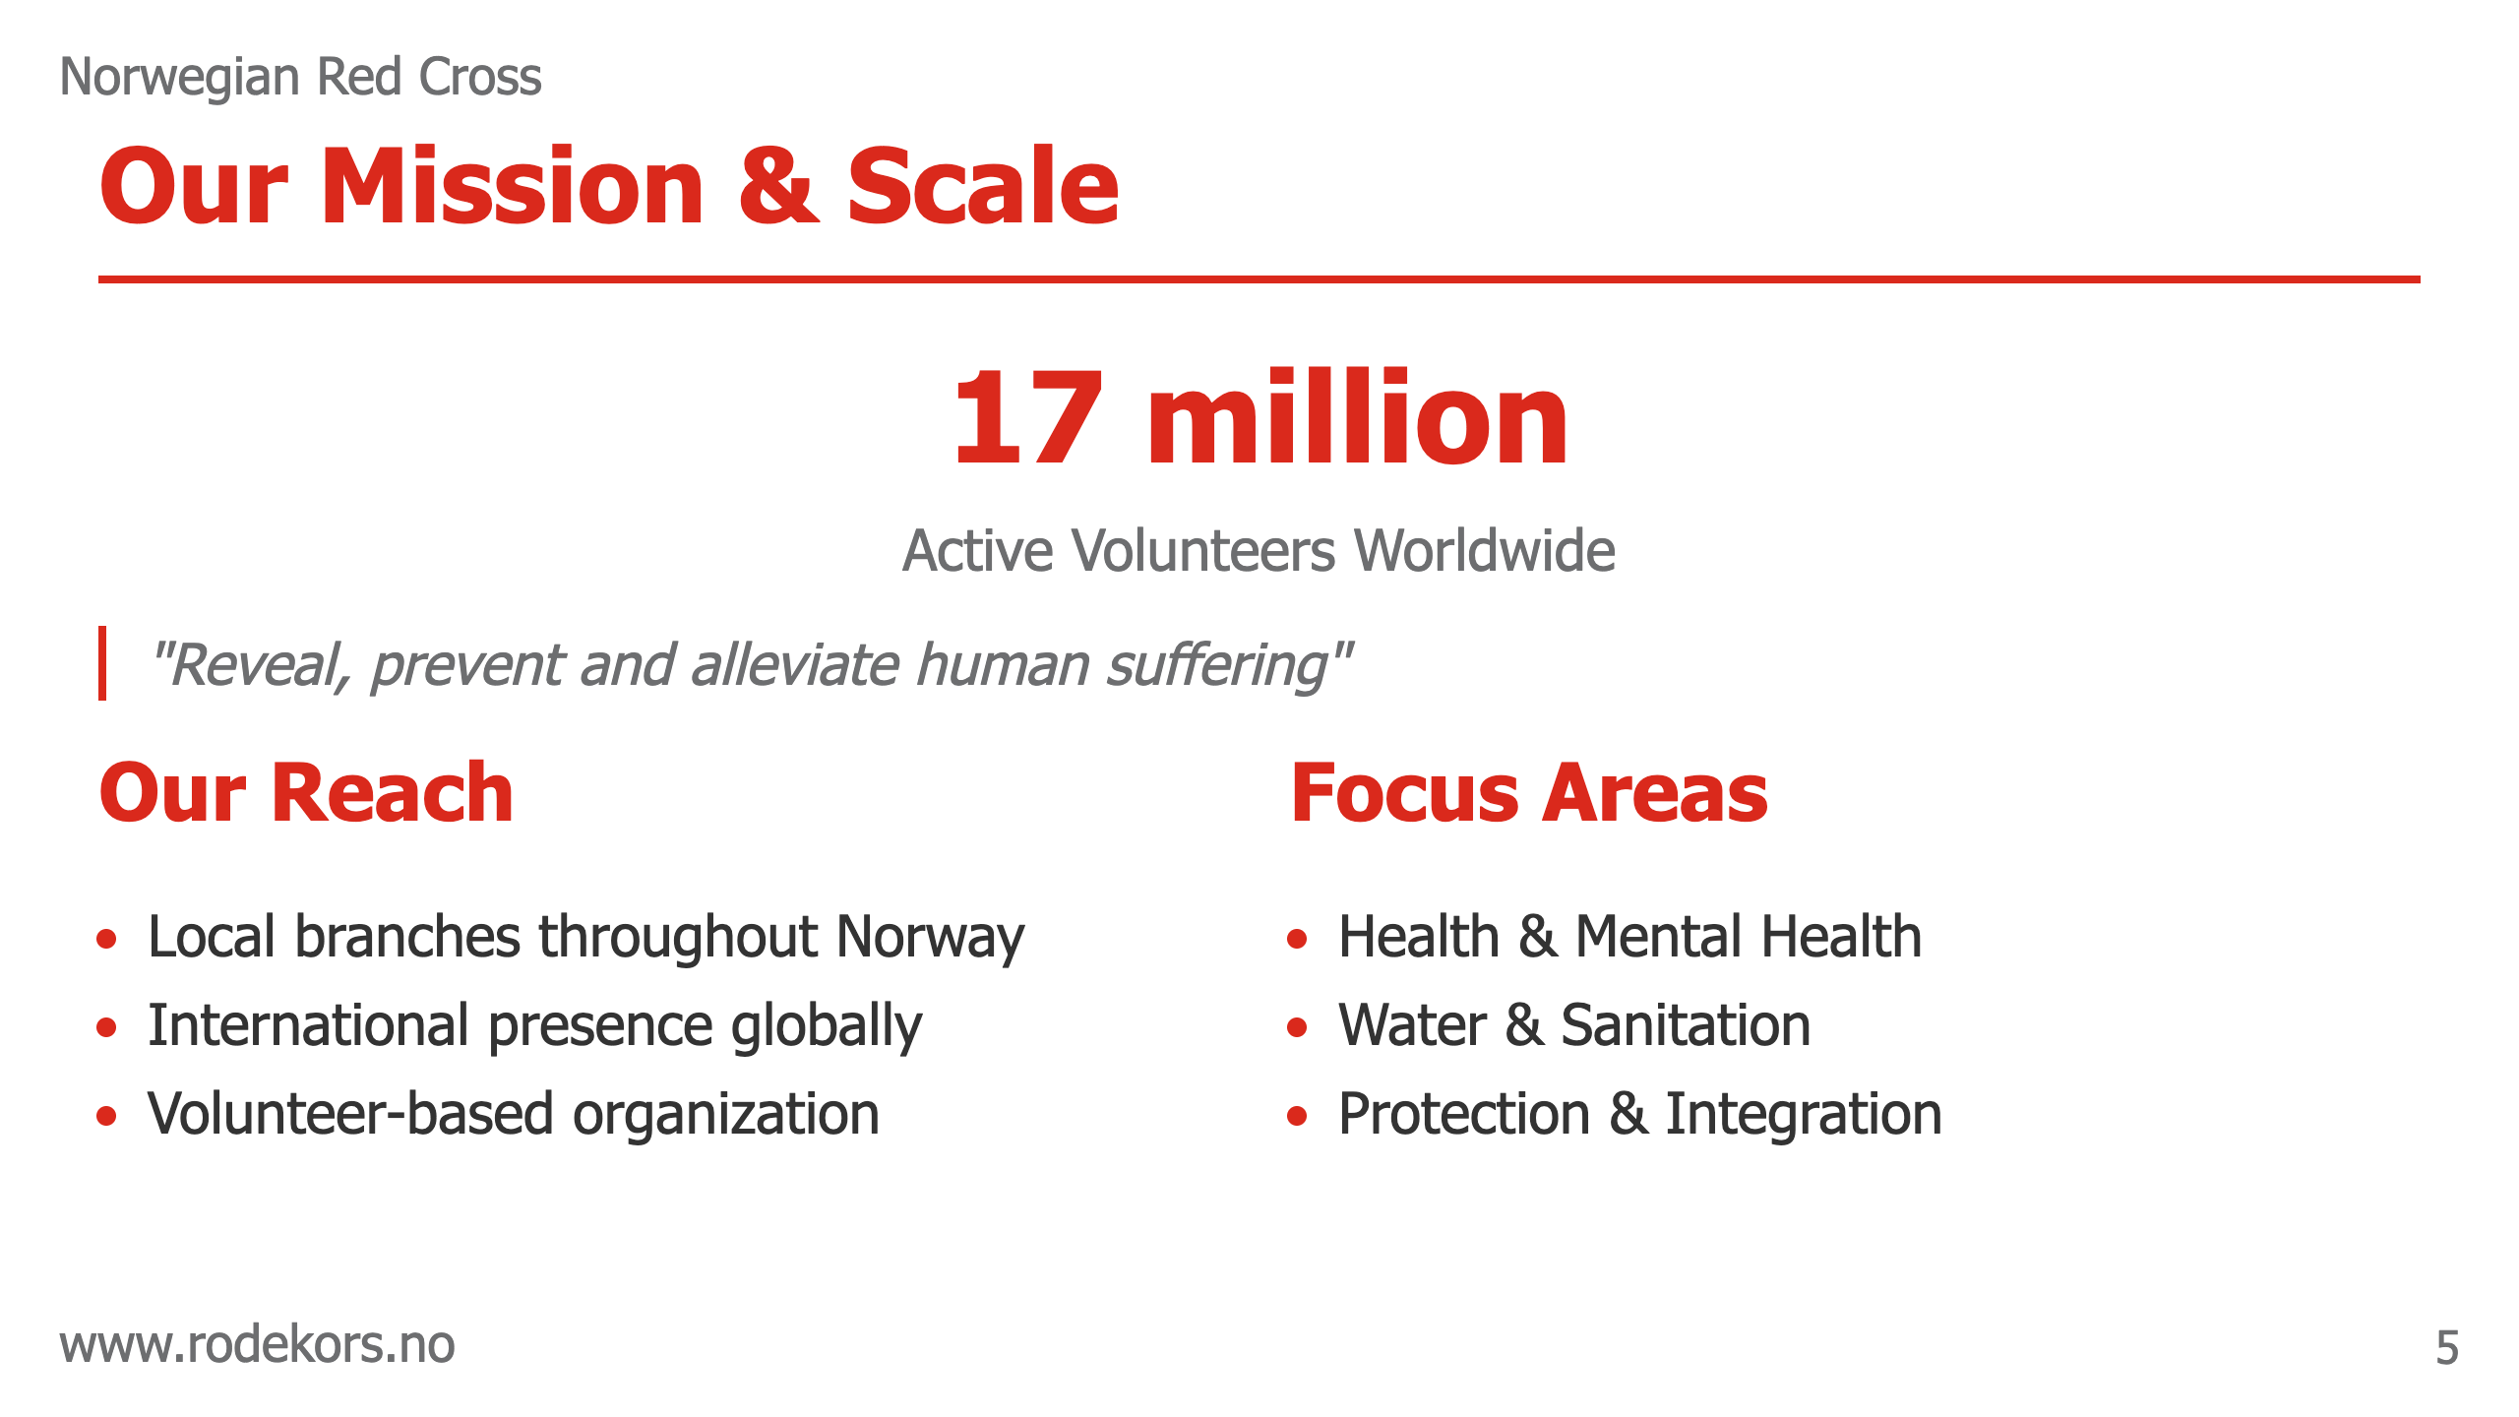
Notes:
@design: design-2-rows-top-text-bottom-columns @slide: slide-mission-scale Simple mission statement with key statistics and focus areas.

Slide 6

Notes:
@design: design-image-left-text-right @slide: slide-global-network Show local-global connection with official IFRC emblem.

Slide 7

Notes:
@design: design-section-divider @slide: slide-section-2-intro Overview of the diverse programs and activities we run to serve communities across Norway and globally.

Slide 8

Notes:
@design: design-image-right-text-left @slide: slide-community-learning Simple overview of language programs with key statistic.

Slide 9

Notes:
@design: design-image-left-text-right @slide: slide-innovation-health Showcase technology innovation with visual and key statistic.

Slide 10
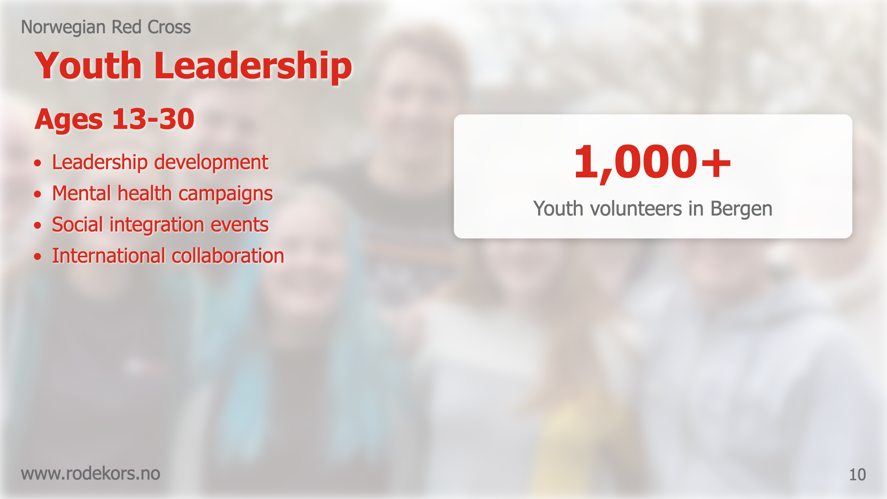
Notes:
@design: design-image-background-2-columns @slide: slide-youth-leadership Youth program overview with background image behind text.

Slide 11
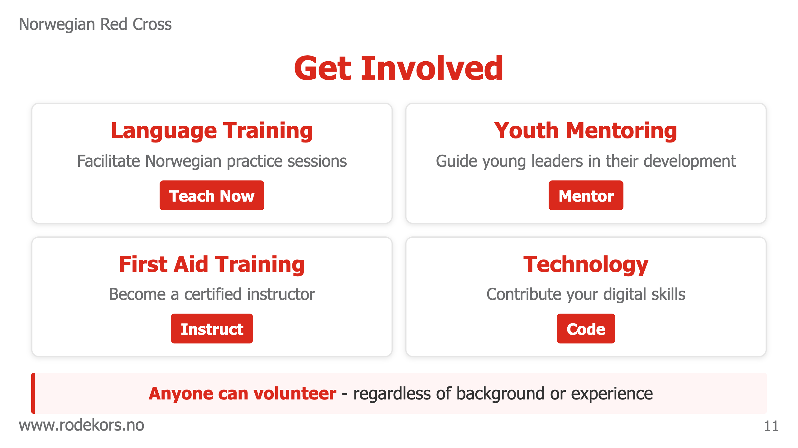
Notes:
@design: design-2-columns-highlight-box @slide: slide-get-involved-grid Simple call to action with key volunteer roles.

Slide 12

Notes:
@design: design-section-divider @slide: slide-section-3-intro Discuss the challenges we face and how we're addressing them with innovative solutions.

Slide 13
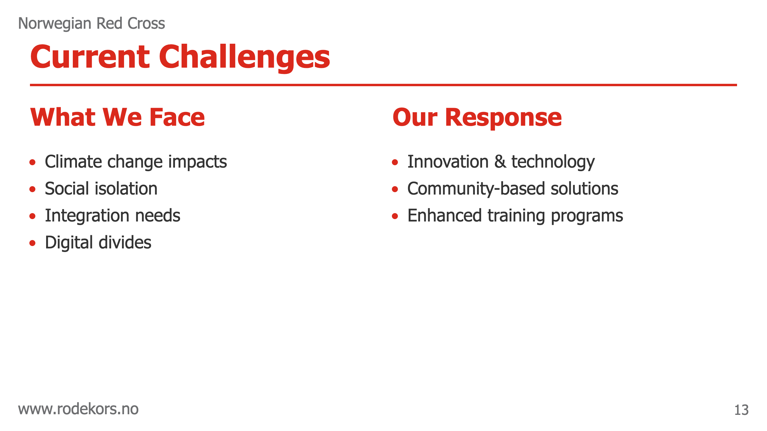
Notes:
@design: design-2-columns @slide: slide-current-challenges Simple challenge overview with response strategy.

Slide 14

Notes:
@design: design-section-divider @slide: slide-section-4-intro Showcase how we use technology to enhance our humanitarian work and create greater impact.

Slide 15

Notes:
@design: design-2-rows-text-image @slide: slide-innovation-action Showcase solutions with key improvement metric.

Slide 16
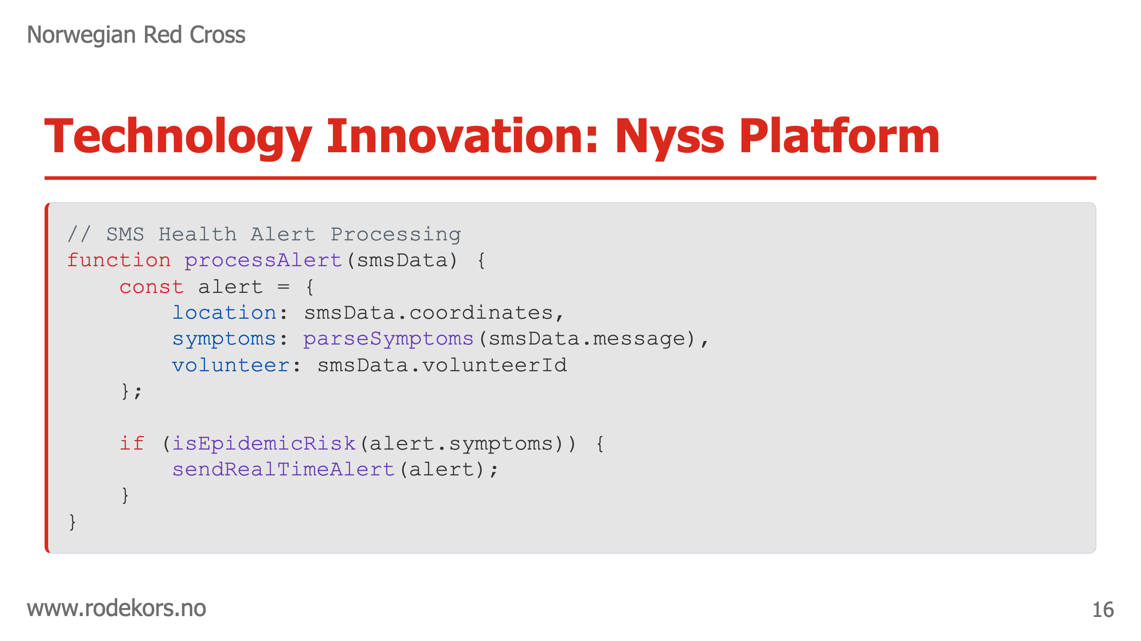
Notes:
@design: design-code-snippet @slide: slide-innovation-nyss Tech innovation example with visual code snippet.

Slide 17
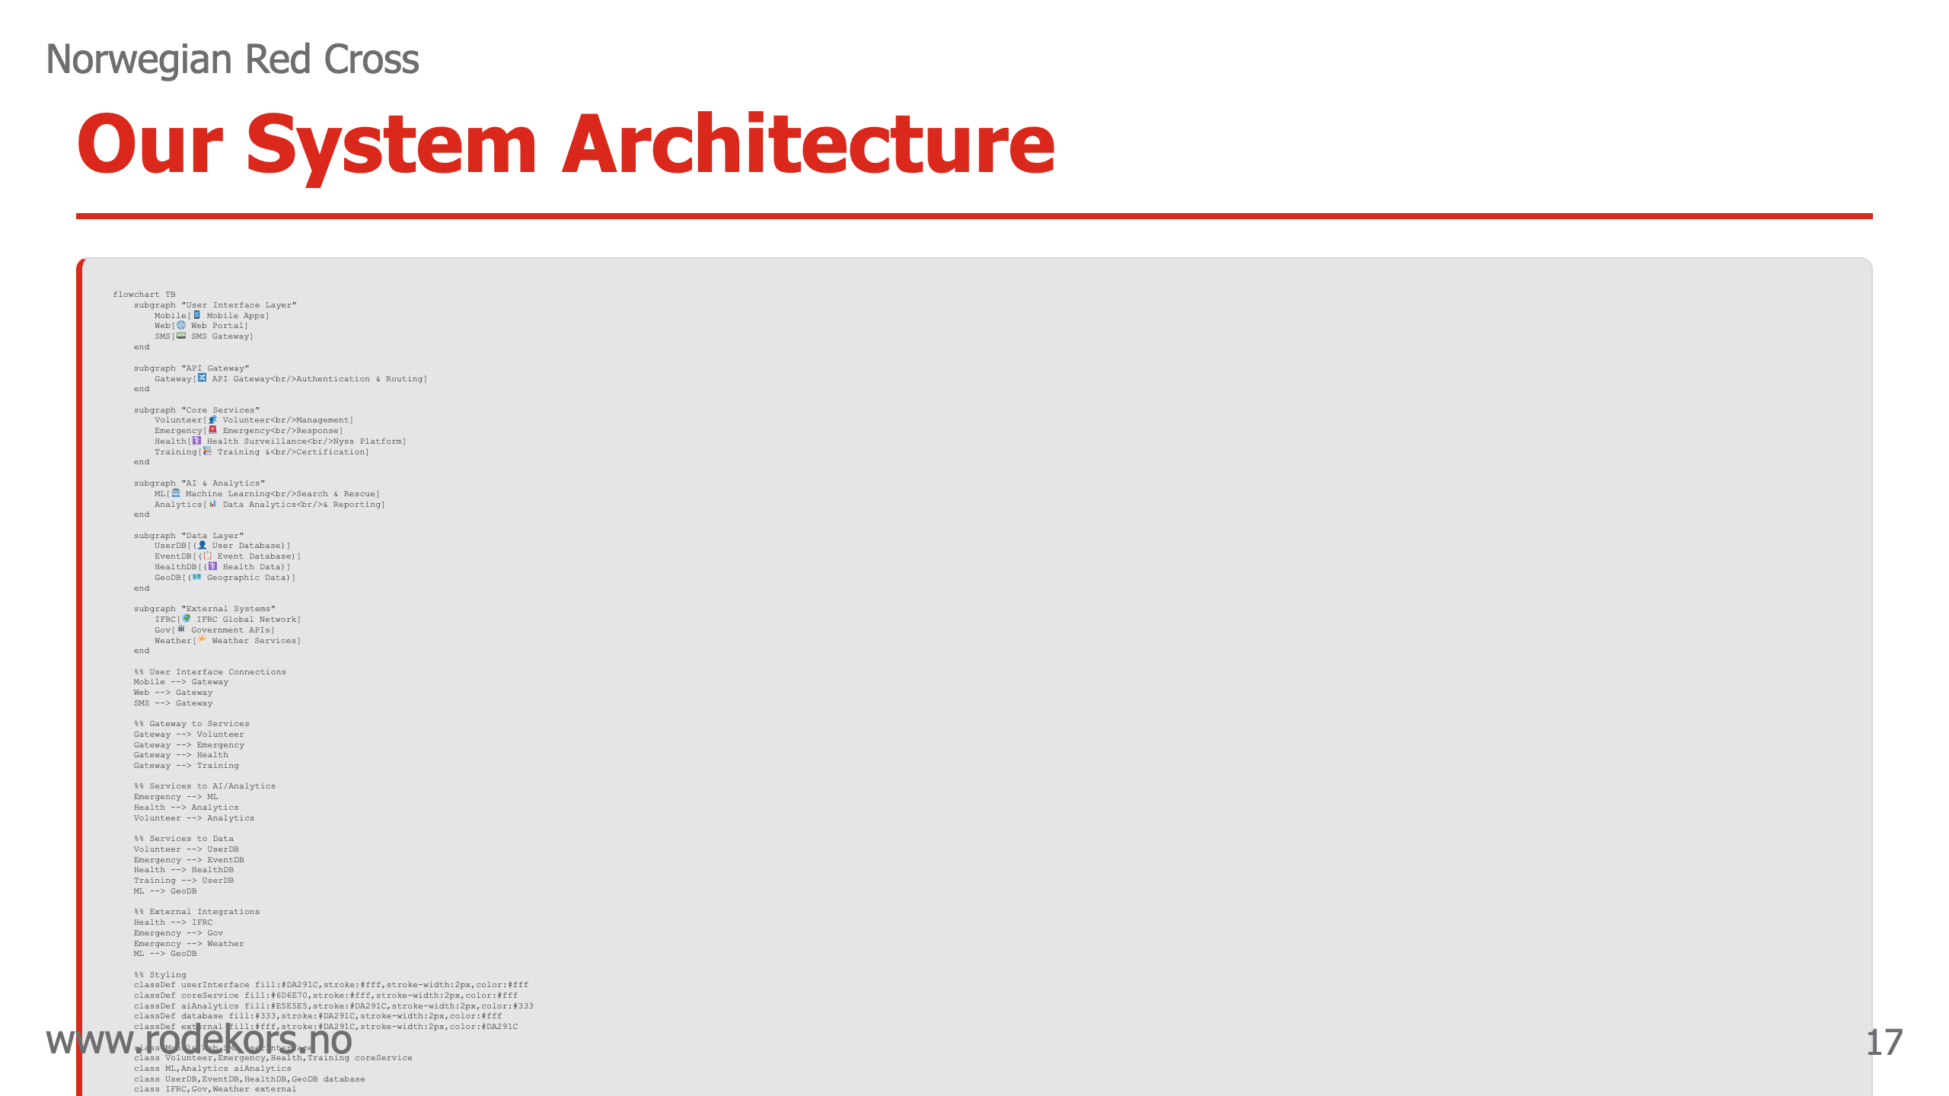
Notes:
@design: design-mermaid-diagram @slide: slide-innovation-system-architecture A diagram of our system architecture.

Slide 18

Notes:
@design: design-section-divider @slide: slide-section-5-intro Inspiring vision of future possibilities when community, technology, and humanitarian values unite.

Slide 19
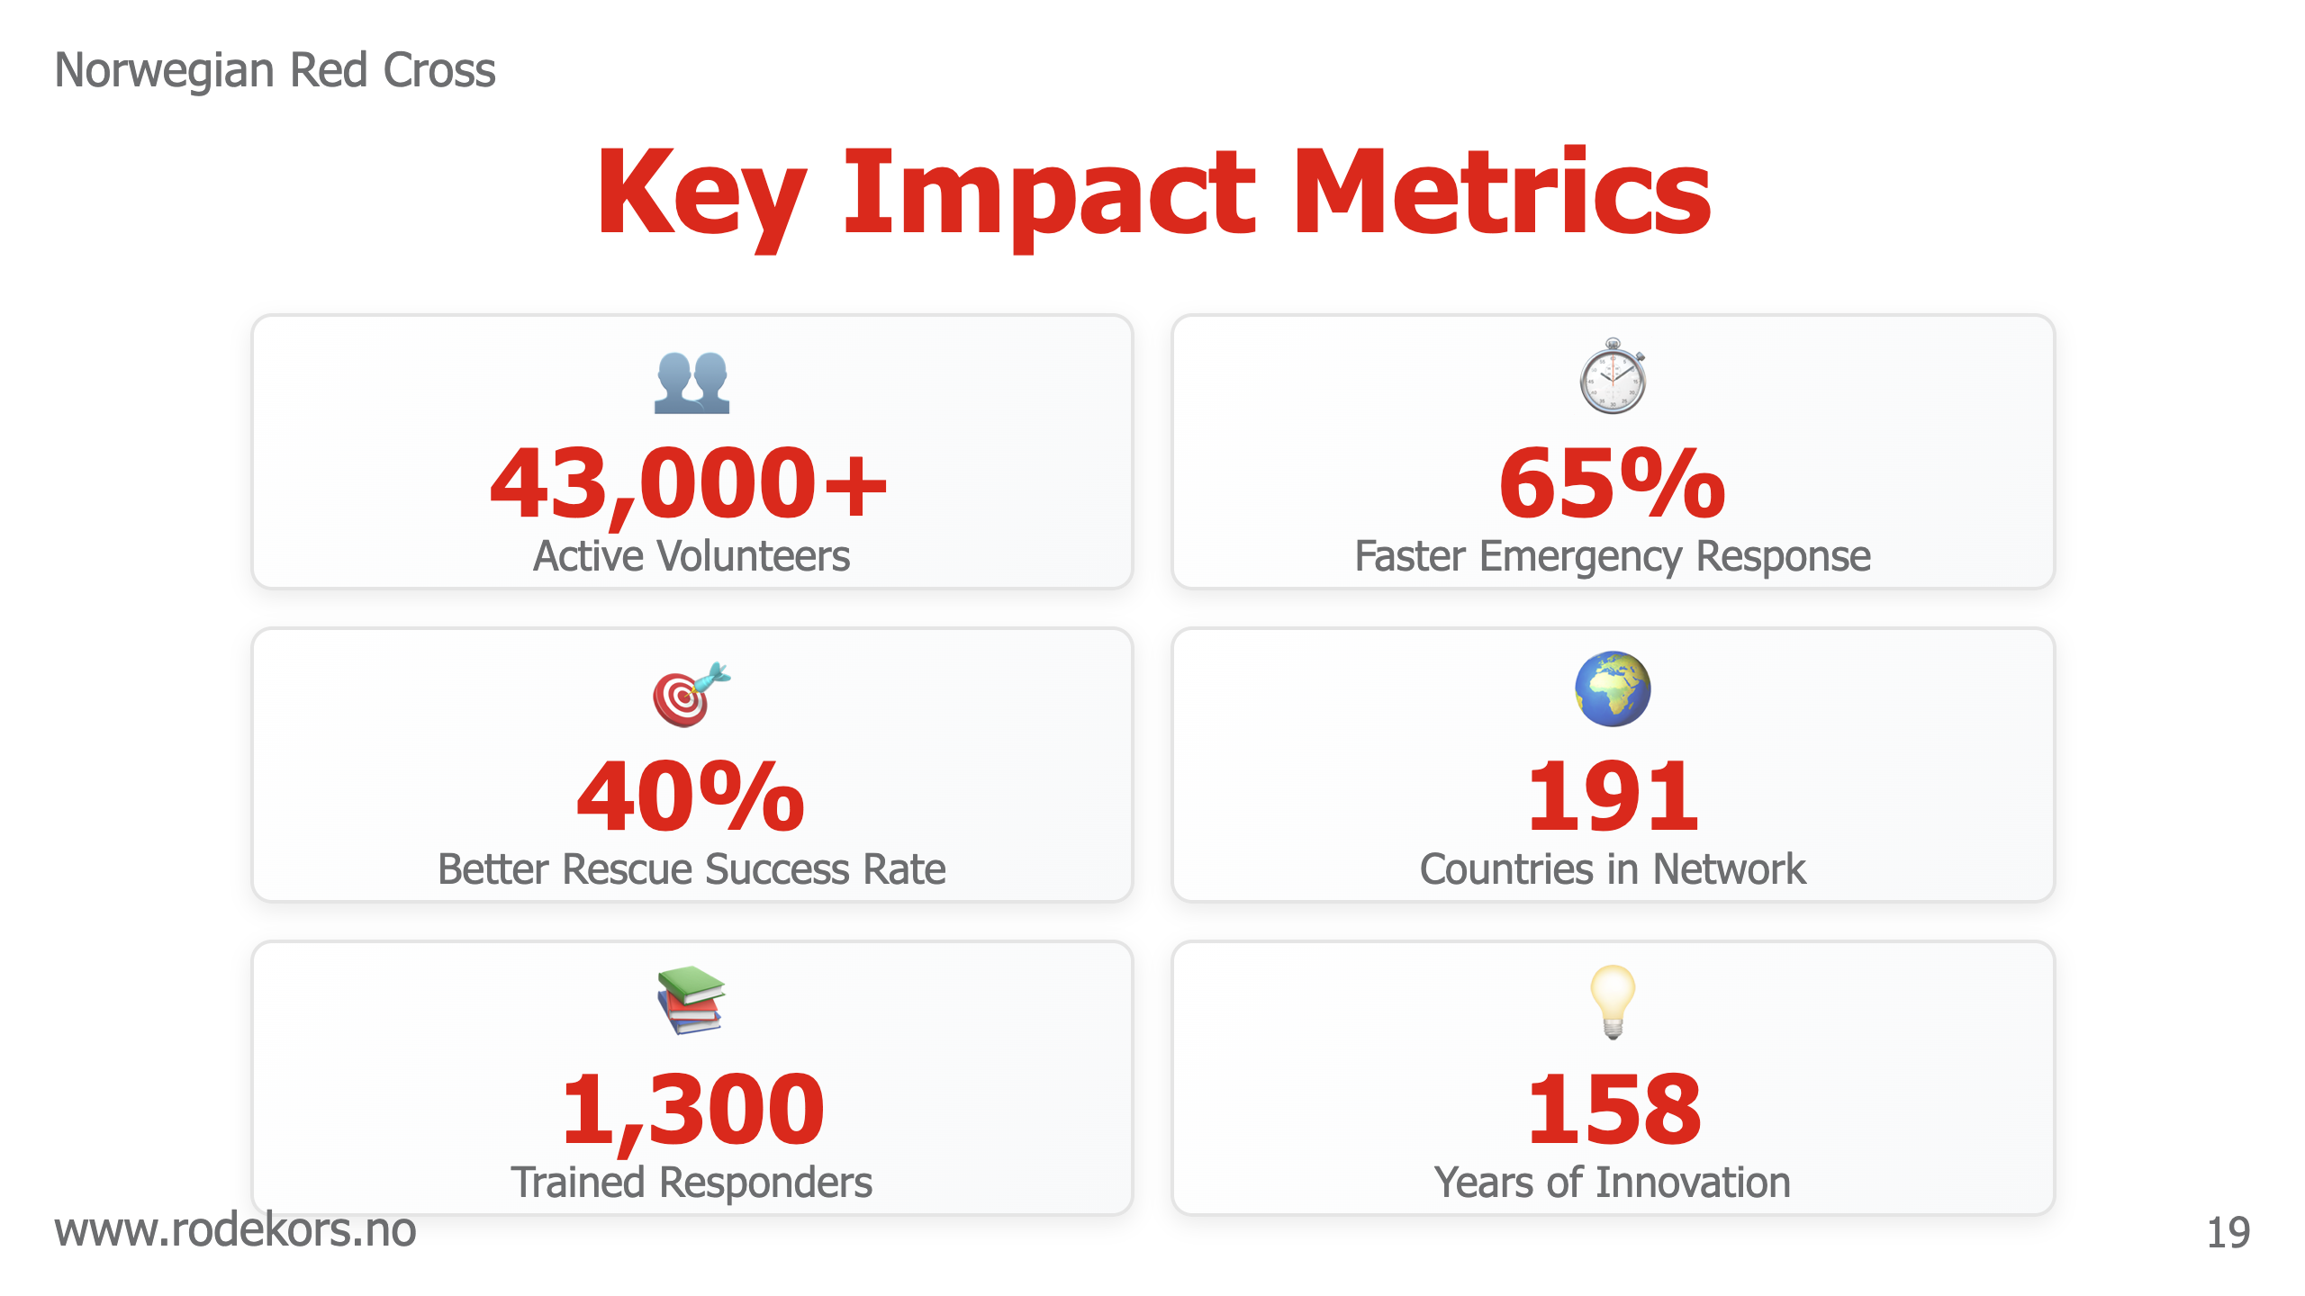
Notes:
@design: design-grid-3-rows @slide: slide-impact-dashboard Inspiring future vision with visual focus.

Slide 20

Notes:
@design: design-quote @slide: slide-questions-discussion Invite questions. Be ready to elaborate on any topic or share additional stories.

Slide 21

Notes:
@design: design-title @slide: slide-thank-you Thank the audience for their time and attention. End on a positive note about how technology and human compassion work together to build better communities.

